Slide 1
Project:
MealMate
Subject: CS691
Computer Science
Project 1

Slide 2
Agenda
Team members roles and responsibilities
Improvements made from professor feedback
Project description
Team working agreement
Personas
MVP
Technologies
Algorithm
Diagrams
Sprint 1 Recap
Product Backlog
Sprint 3 Backlog
Metrics
Retrospective
Sprint 2
Project Demo
Github link
Live application Demo

Slide 3
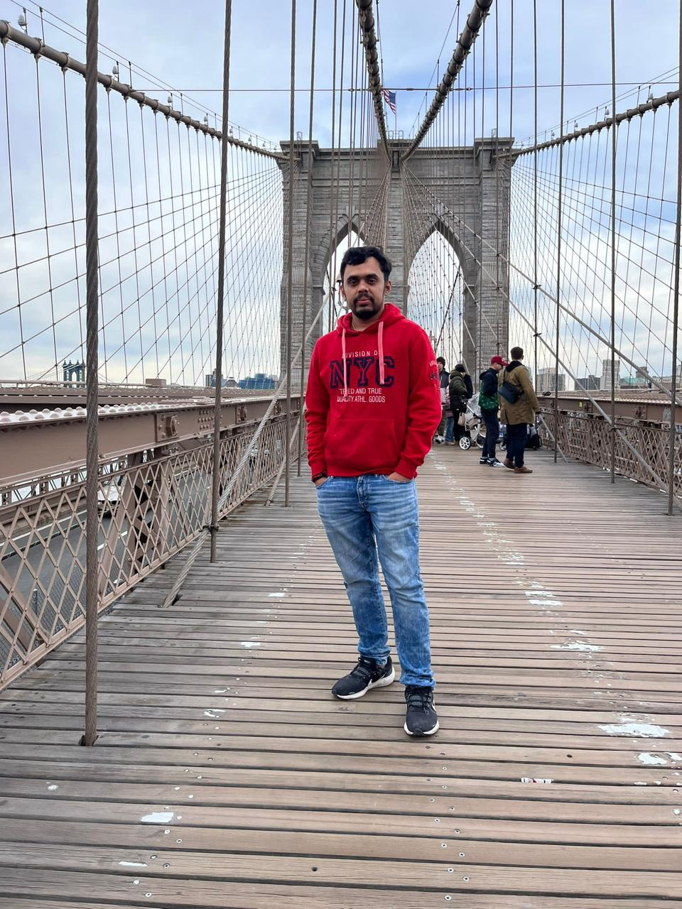
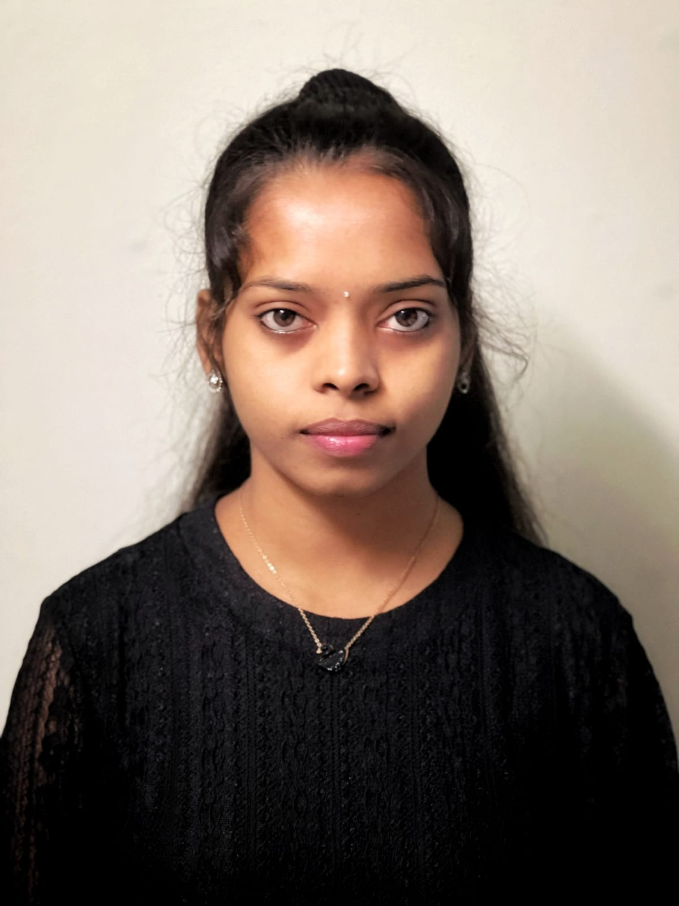

Team Members Roles
Sarath Upadrista
Full Stack Developer and Devops
Archana
Project Manager
Quality Analyst & Tester
Dharavath, Harika
Mobile Application Developer and UI/UX

Slide 4

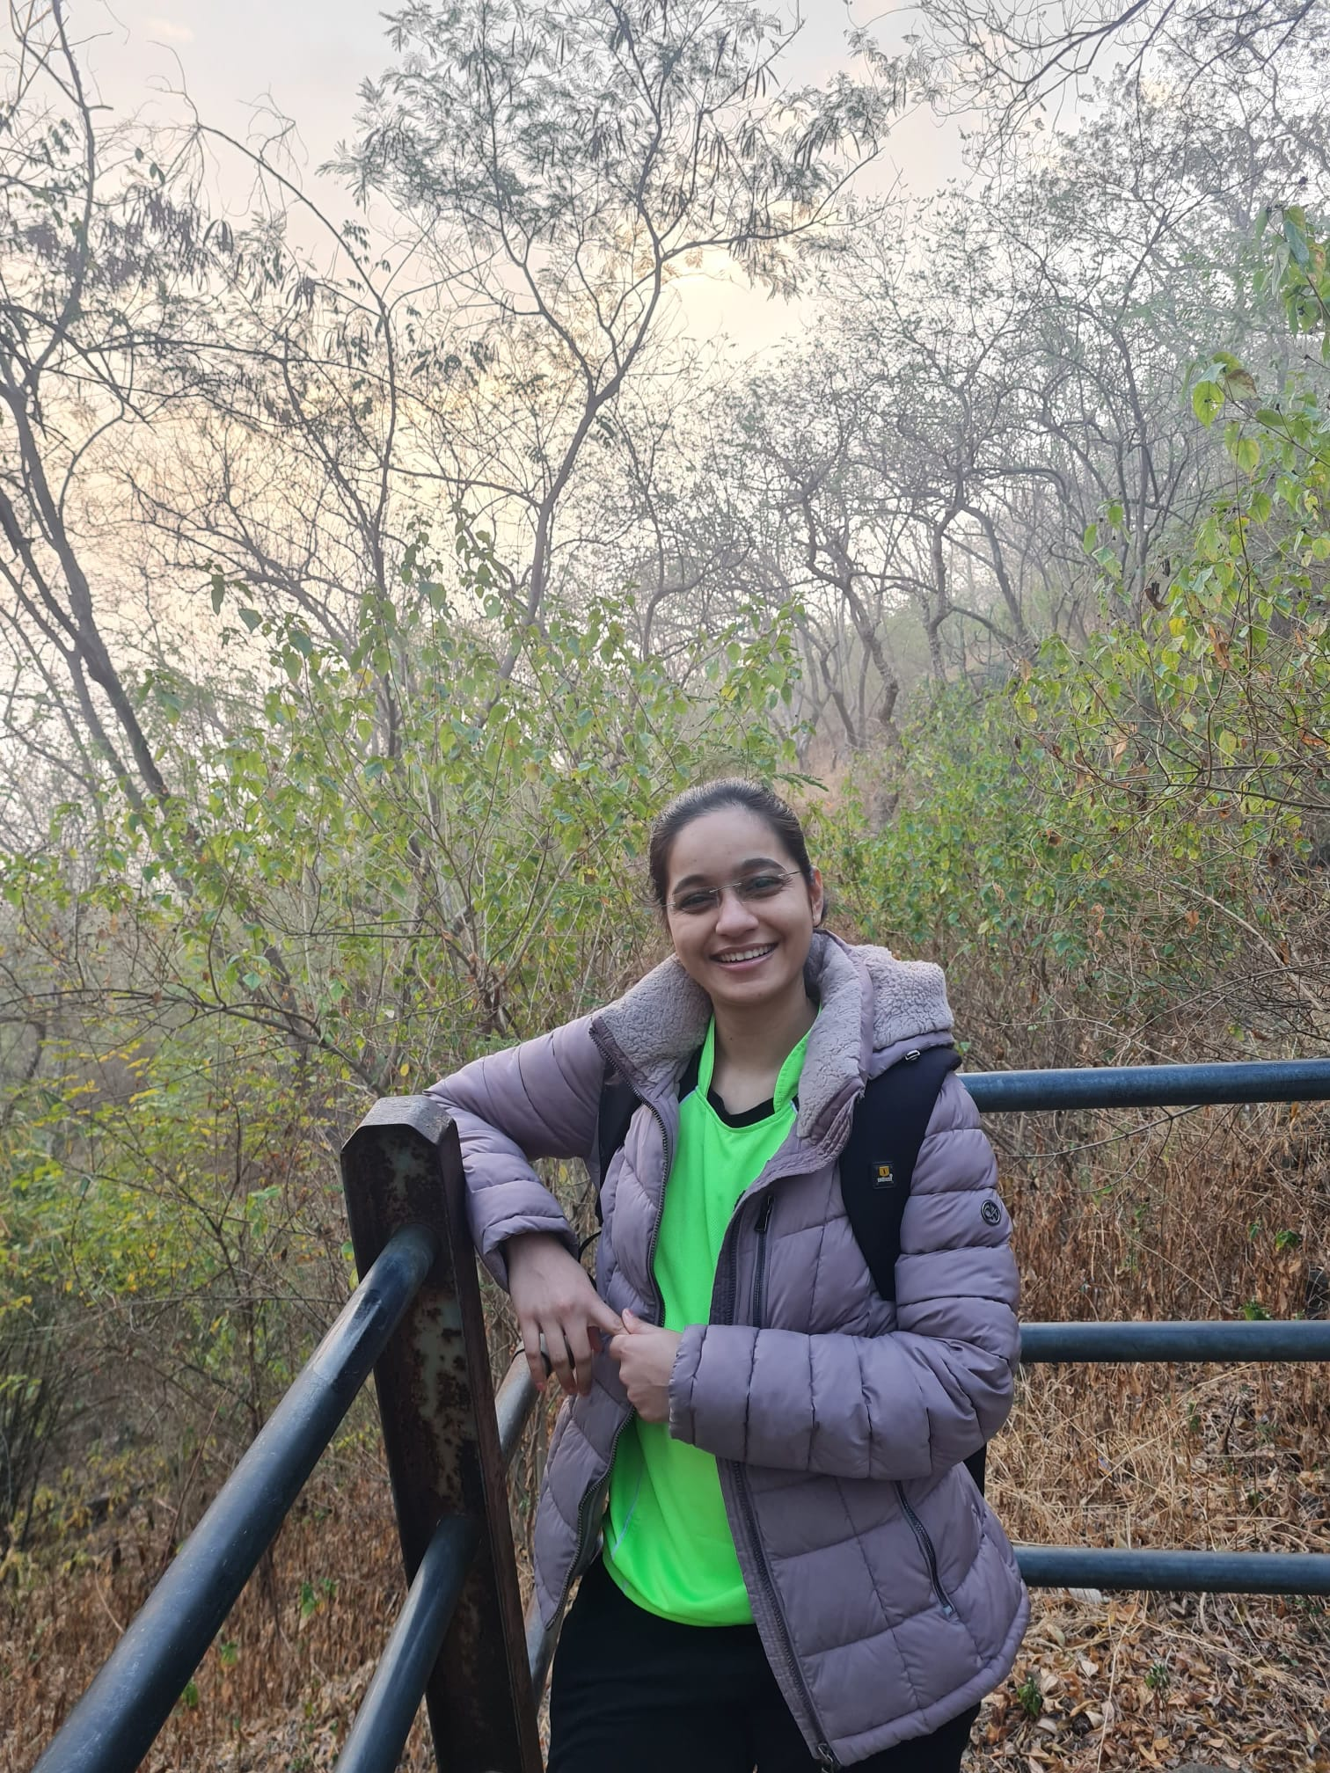
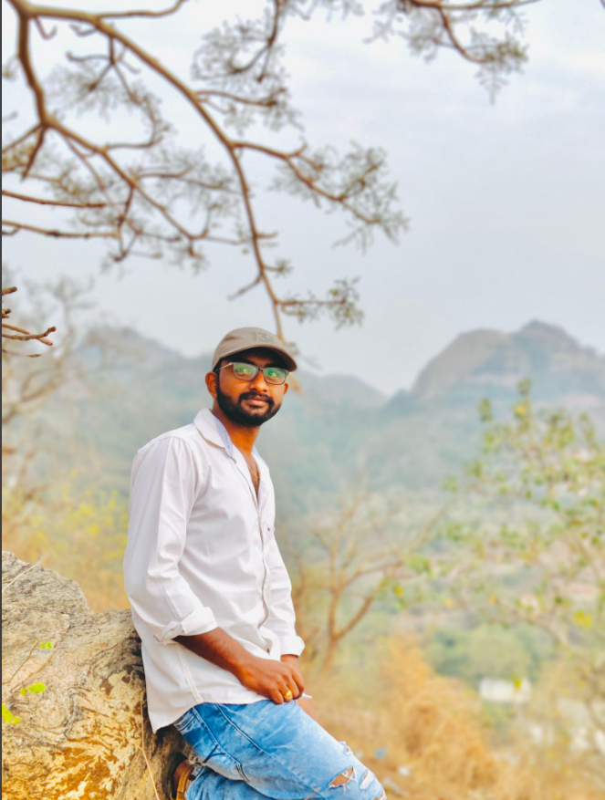
Team Members Roles
Pavan
Cloud Engineer and Developer
Avhad, Dipali Vijay
Developer and tester
Kundan Sai Datta Prasad,Gowru
Backend Developer and DevOps

Slide 5
Improvements made from Professor's Feedback
Post the deliverable 2 presentation, we received feedback from the professor on adding the 'Sprint Burndown Chart', 'Completed/Committed Ratio', 'Team Velocity Chart', and 'Team's Historical Velocity (Average)' slides are included in the presentation as per the checklist. which we did accordingly which can be seen in the further slides.
we received feedback from the professor to add test cases include User Story IDs to link them with the corresponding stories, indicating which stories the tests belong to.
we received feedback from the professor to follow the order from the slide checklist present in your checklist workbook.
we received feedback from the professor to utilizing the user stories syntax by including 'so that' after the functionality. For example, 'As a [user], I want [functionality], so that [benefit from it]'.

Slide 6
Project Description
Project Description
Project Name: | MealMate
Team Name: | MealMate
Project Description: | Introducing "Meal Mate" – your new kitchen companion! Simplifying meal planning with smart technology. Just snap a pic of your veggies, and we'll handle the rest, suggesting recipes tailored to your ingredients. Say goodbye to cooking stress! For customers who want to know the recipes using vegetable images, the MealMate is a mobile app that provides recipes suggestions , unlike the traditional way where we had to look into the youtube channels or recipe books our solution provides the easy way to get the suggested recipes using the available vegetables at the home.
Benefit Outcomes: | Users can effortlessly discover recipes with Meal Mate by simply snapping a pic of your veggies, eliminating the need for browsing YouTube or recipe books Users can enjoy convenient access to personalized recipe suggestions based on available vegetables at home with Meal Mate, streamlining your cooking experience.
GitHub Wiki: | https://github.com/upadristasarath/CS691_CapstoneProject_MealMate

Slide 7
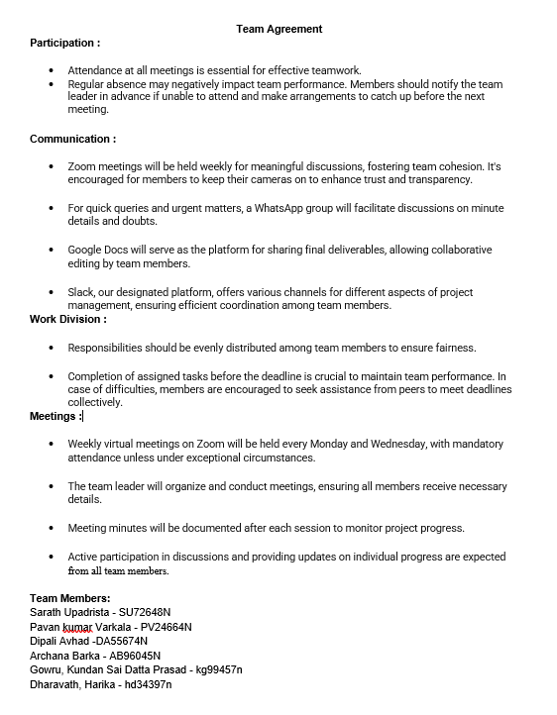
Team Working Agreement

Slide 8

Personas

Slide 9

Persona 1
Profile:
Sarah is a busy marketing executive who often struggles with meal planning due to her demanding job. She enjoys cooking but finds it challenging to make time for it amidst her busy schedule.
Interests:
Sarah enjoys experimenting with new recipes and flavors when she has the time. She is interested in maintaining a healthy lifestyle but struggles to find the time to plan and prepare nutritious meals.
Frustration:
Sarah is frustrated by the lack of time she has to plan and prepare meals, often resorting to unhealthy takeout options due to her busy schedule.
Goals:
Sarah's goal is to find a convenient solution for meal planning that fits into her busy lifestyle. She wants a tool that can help her quickly and easily plan nutritious meals using the ingredients she already has at home.
Demographics:
Name: Sarah Age: 32 Occupation: Marketing Executive

Slide 10
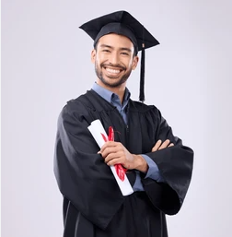
Persona 2
Profile:
Michael is a recent college graduate who has just moved into his first apartment. He is eager to learn how to cook but feels overwhelmed by the variety of ingredients available at the grocery store.
Interests:
Michael is interested in learning how to cook simple and nutritious meals that he can enjoy at home. He wants to improve his culinary skills and become more confident in the kitchen.
Frustration:
Michael is frustrated by his lack of experience in the kitchen and feels overwhelmed by the prospect of cooking for himself. He often struggles to come up with meal ideas and ends up ordering takeout instead. Goals:
Michael's goal is to improve his cooking skills and become more confident in the kitchen. He wants a tool that can provide him with easy-to-follow recipes based on the ingredients he has on hand, helping him to experiment with new flavors and techniques.
Demographics:
Name: Michael Age: 25 Occupation: Recent College Graduate

Slide 11
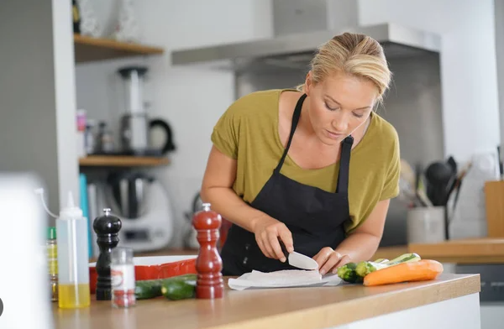
Persona 2
Profile:
Emily is a dedicated stay-at-home mom who prioritizes providing healthy meals for her family. She wants to reduce food waste and find creative ways to incorporate vegetables into her family's diet. Interests:
Emily is passionate about cooking and enjoys finding new recipes to try. She is interested in nutrition and wants to ensure that her family eats balanced meals that are both healthy and delicious.
Frustration:
Emily is frustrated by the challenge of finding new and exciting recipes that her family will enjoy. She often feels guilty about wasting food and wants to find ways to reduce food waste in her household. Goals:
Emily's goal is to find a tool that can help her plan healthy and balanced meals for her family while also reducing food waste. She wants an app that can suggest creative recipes based on the ingredients she has in her pantry, making mealtime both nutritious and enjoyable for her family.
Demographics:
Name: Emily Age: 35 Occupation: Stay-at-Home Mom

Slide 12

Minimal Viable Product (MVP)

Slide 13

Minimal Viable Product (MVP)
The following are the features that we are covering in our MVP:
Login Screen
Sign in
Home Page
Camera screen
Profile Screen
History

Slide 14
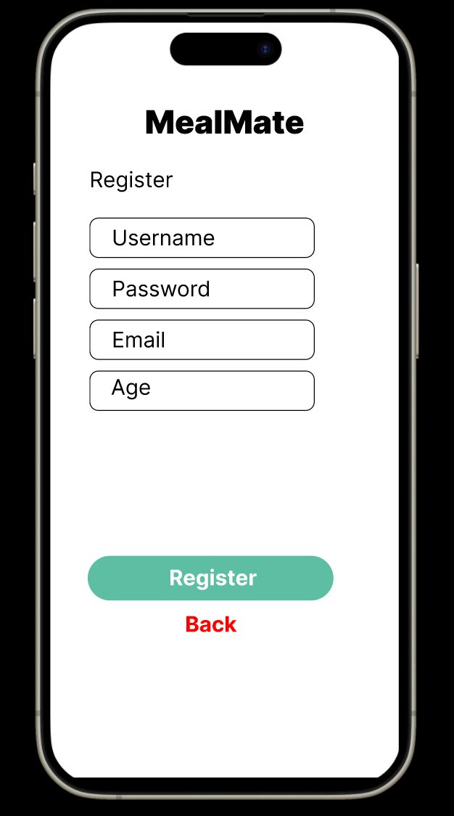
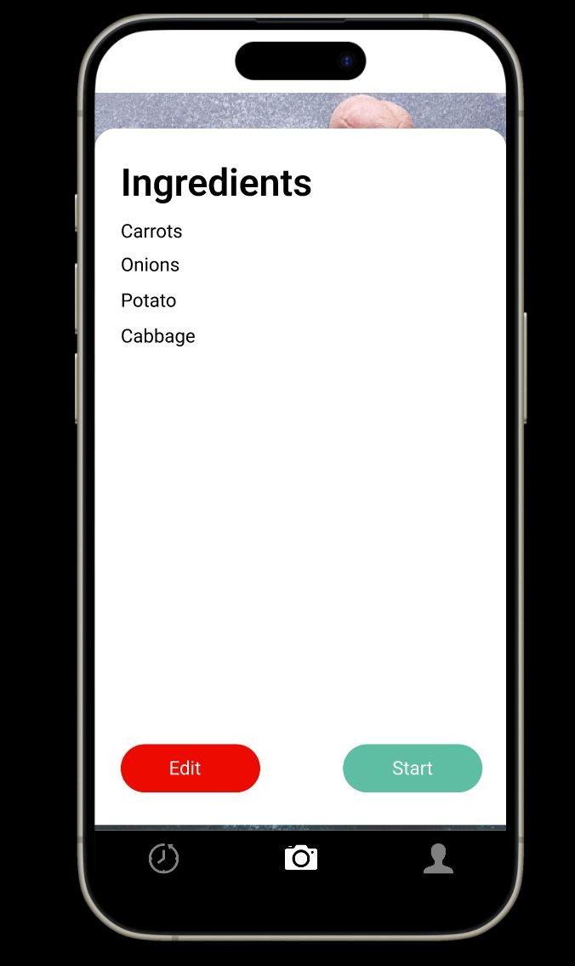
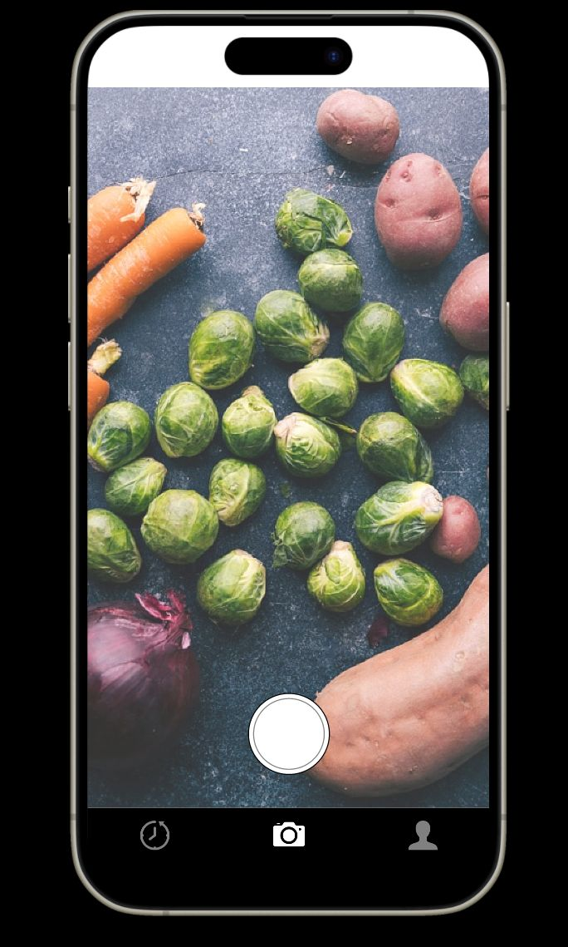
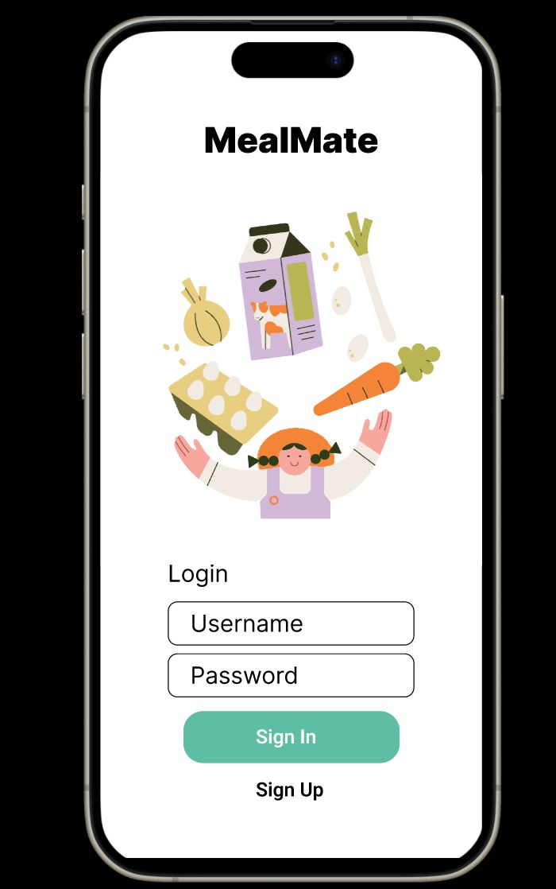
Minimal Viable Product (MVP)

Slide 15
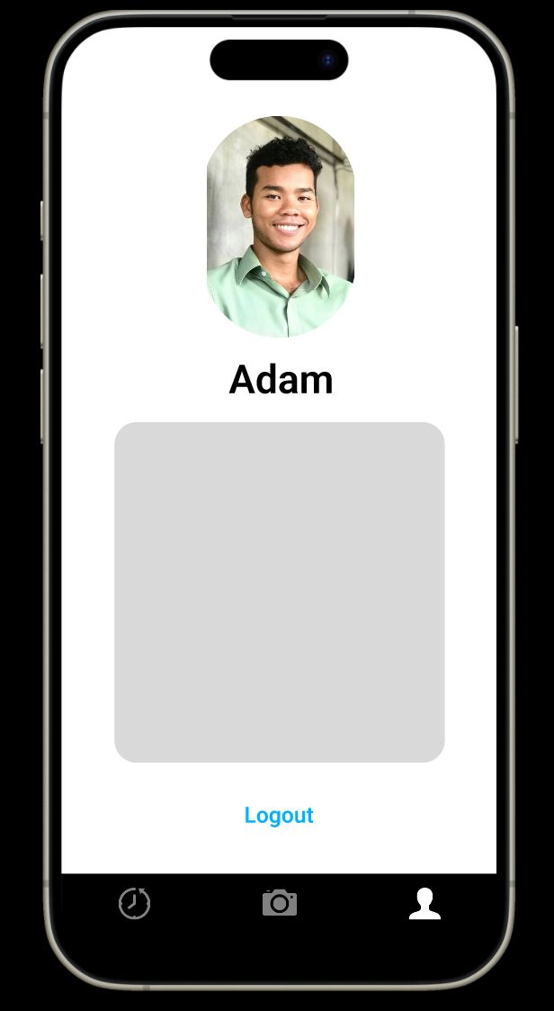
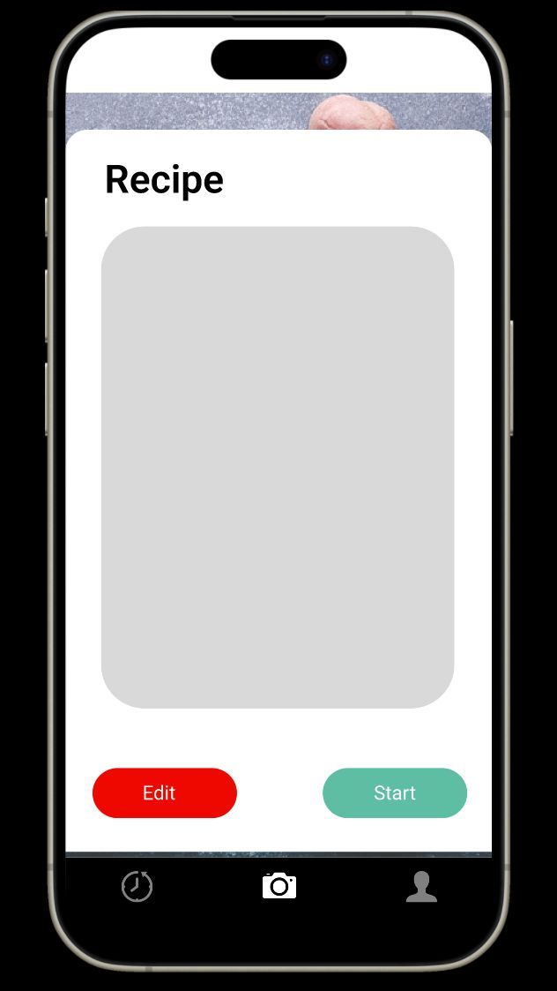
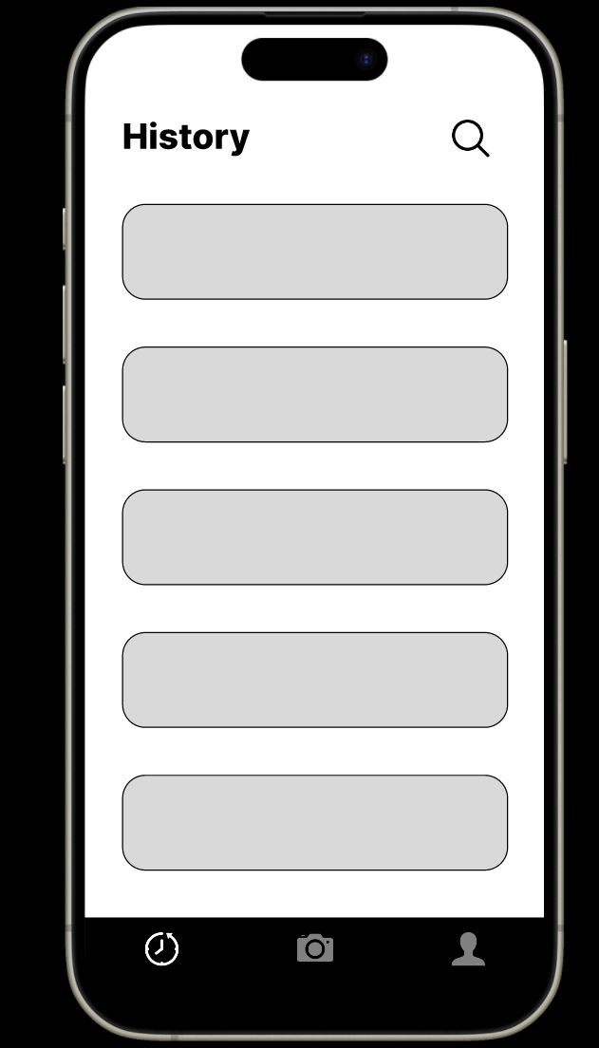
Minimal Viable Product (MVP)

Slide 16
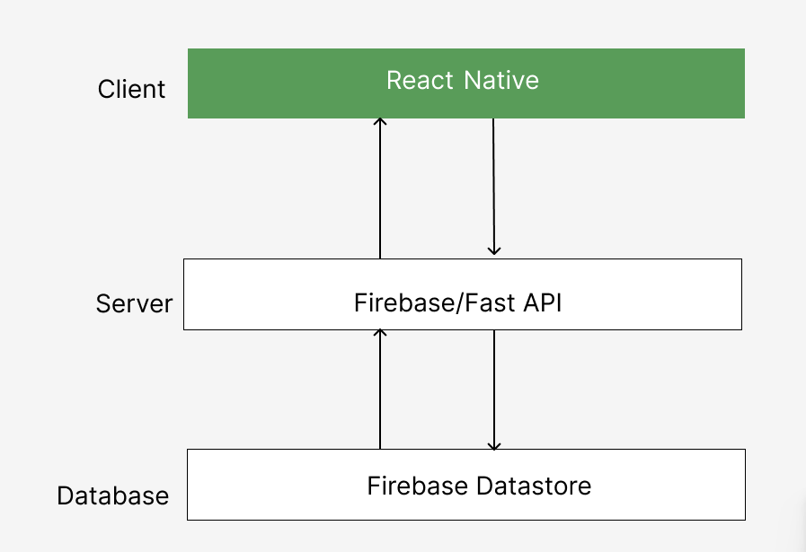
Technologies
React Native
Python
Firebase
FastAPI
Firebase Datastore
ChatGPT API
Git/Github
JIRA

Slide 17
Algorithms
YOLOv7 (You Only Look Once version 7) is the latest advancement in the YOLO series of deep learning models, renowned for their exceptional object detection capabilities. This iteration further enhances the model's accuracy and processing speed, making it exceptionally adept at real-time object detection tasks. YOLOv7 is distinguished by its ability to quickly and accurately identify and classify multiple objects within images or video streams, a feature that has made it indispensable in applications requiring rapid and reliable object detection such as autonomous driving, surveillance systems, and various industrial automation processes. Its improved performance, coupled with its scalability and ease of integration into existing systems, solidifies YOLOv7's position at the forefront of object detection technology.

Slide 18

Diagrams

Slide 19
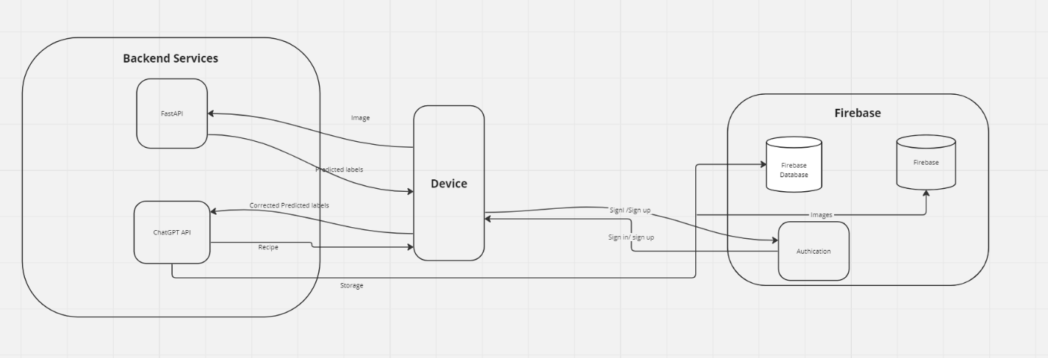
Conceptual Architecture Diagram

Slide 20
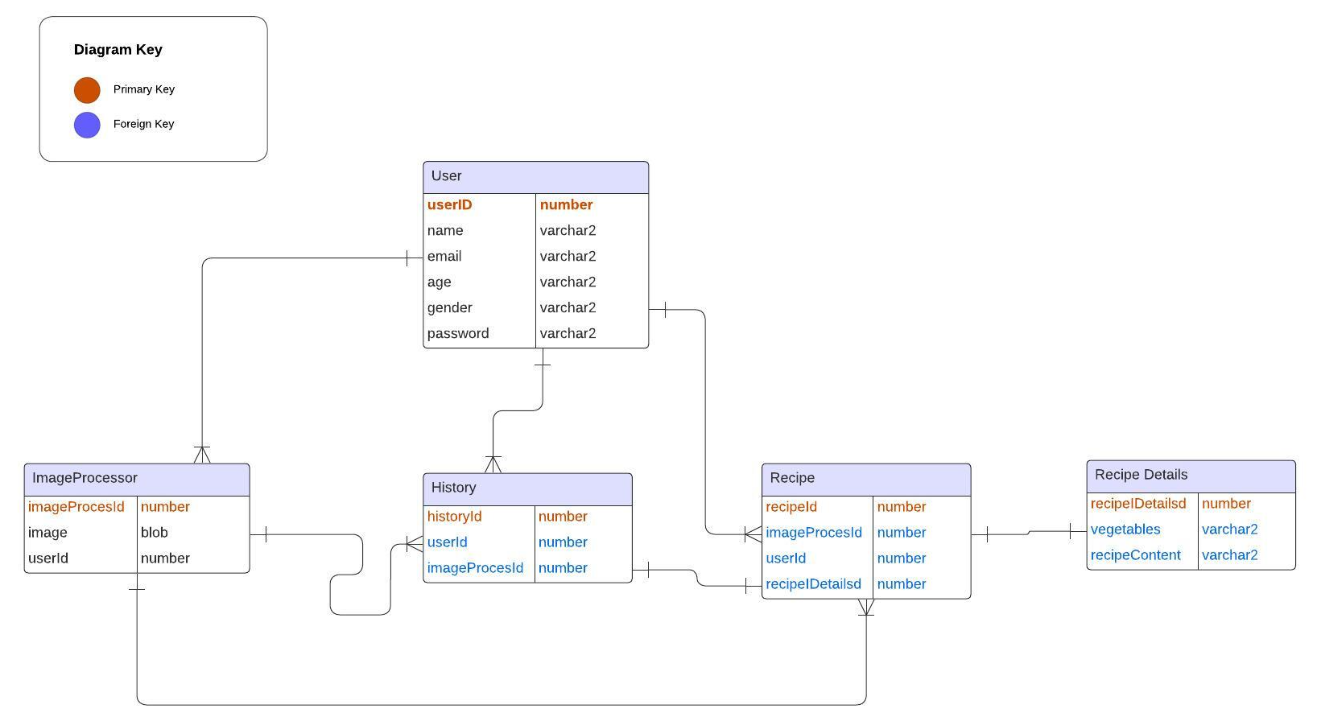
ER Diagram

Slide 21
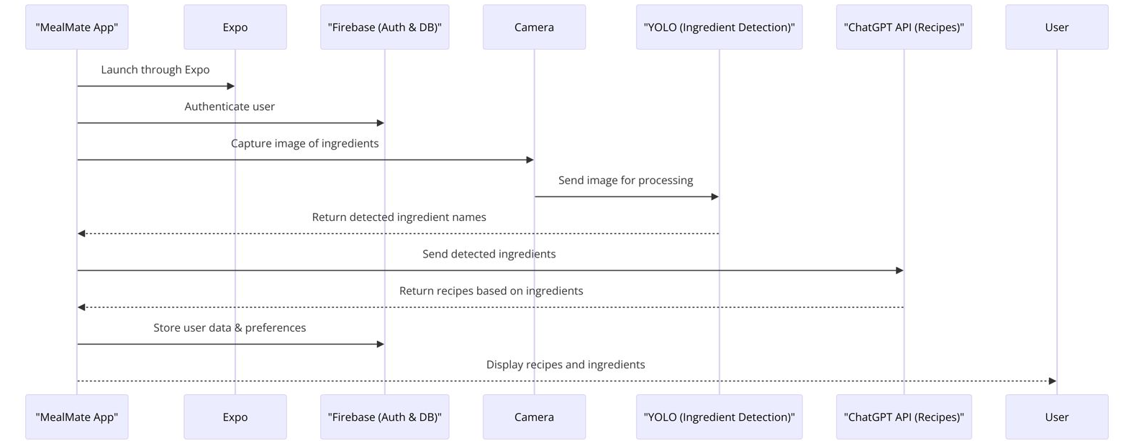
Sequence Architecture Diagram

Slide 22
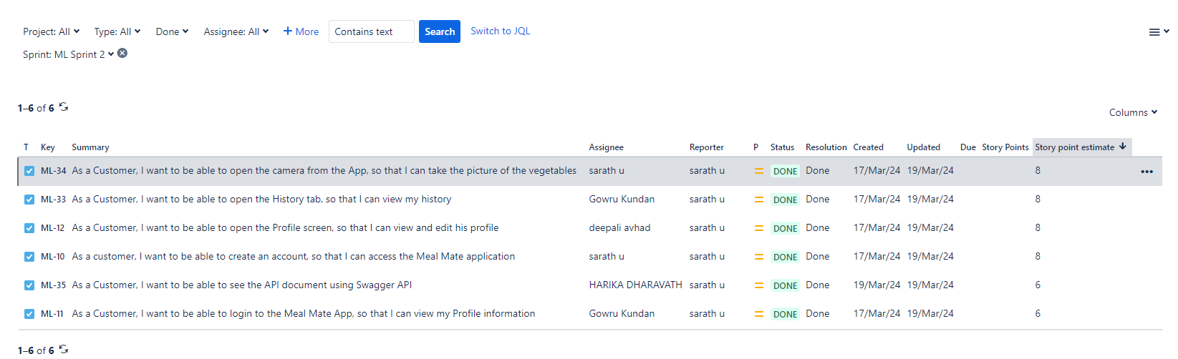
Sprint 1 Recap
Login Screen
Camera Screen
Profile Screen
History Screen

Slide 23
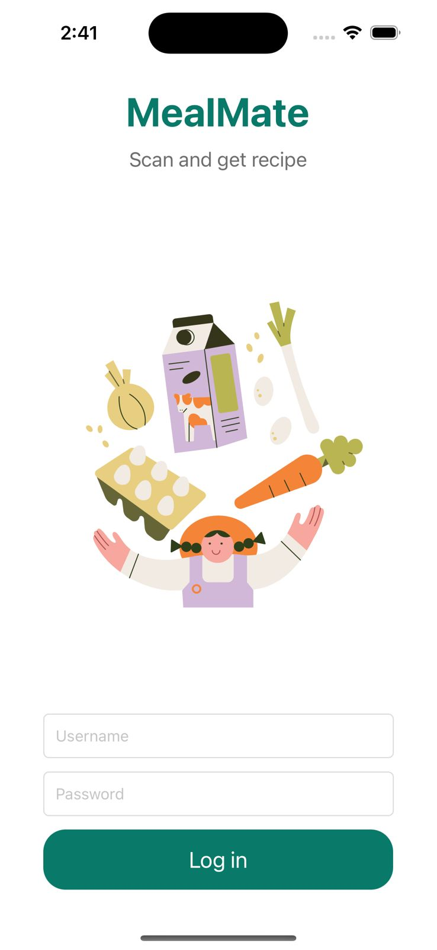
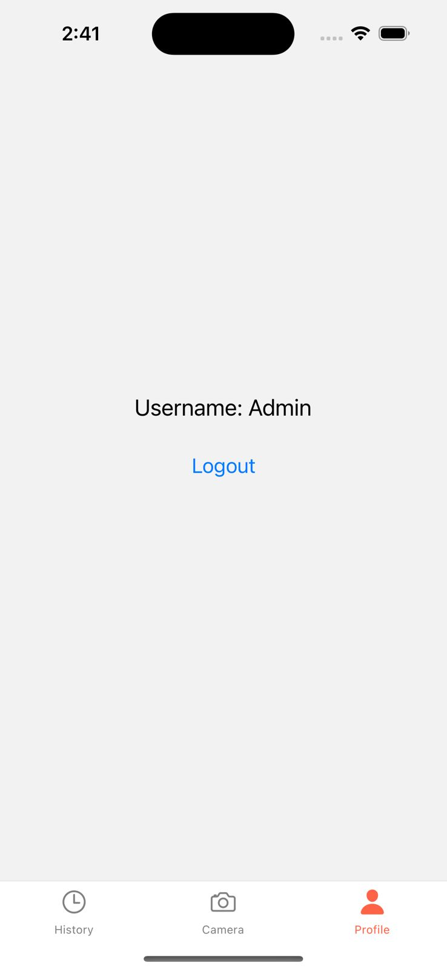
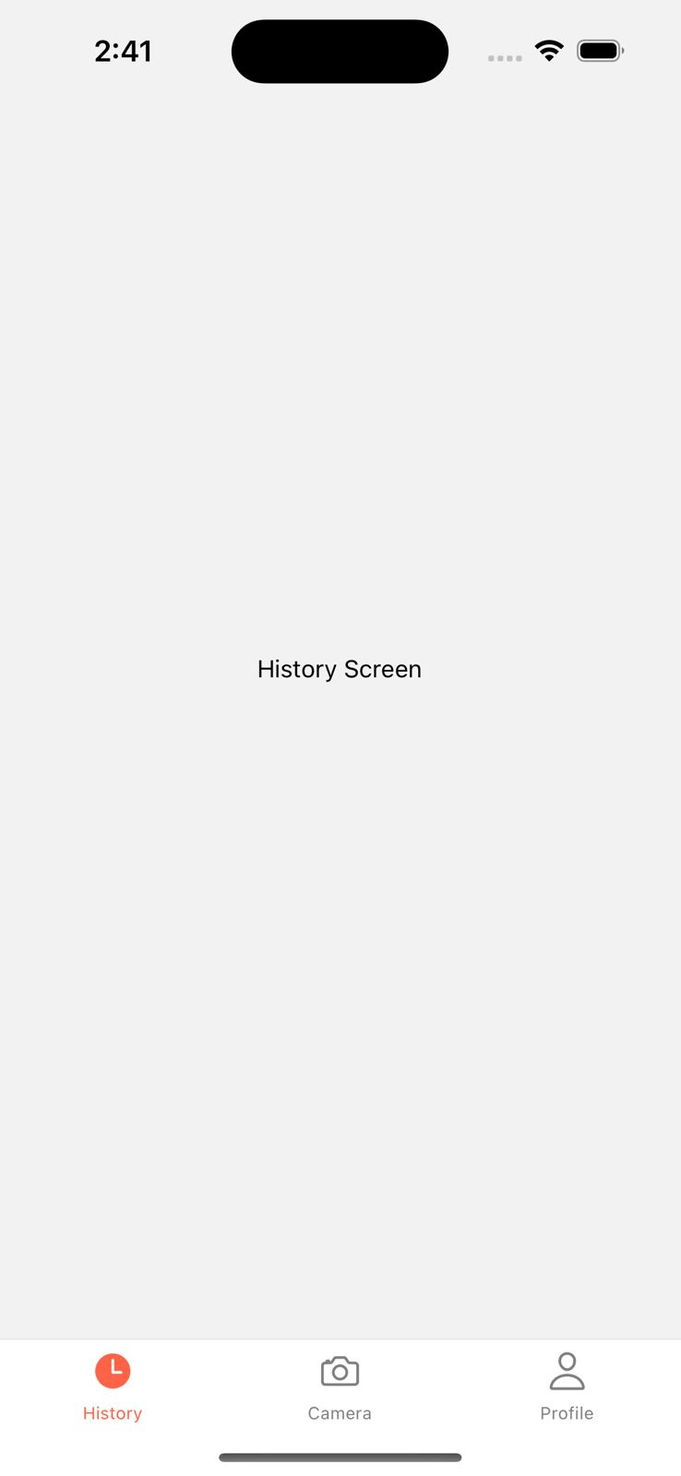

Slide 24
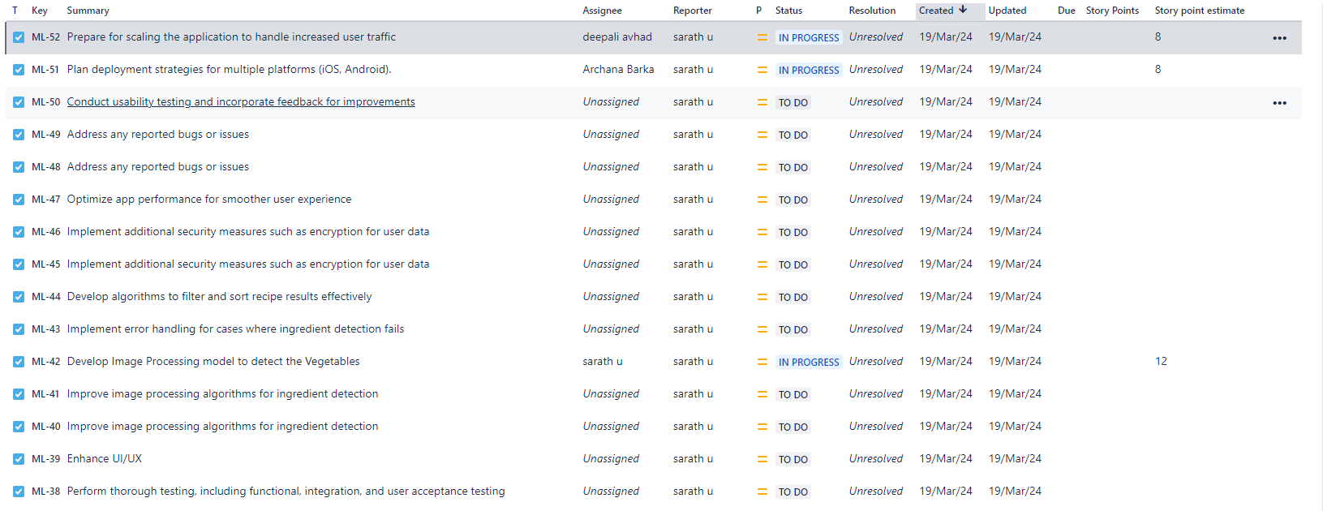
Product backlog

Slide 25
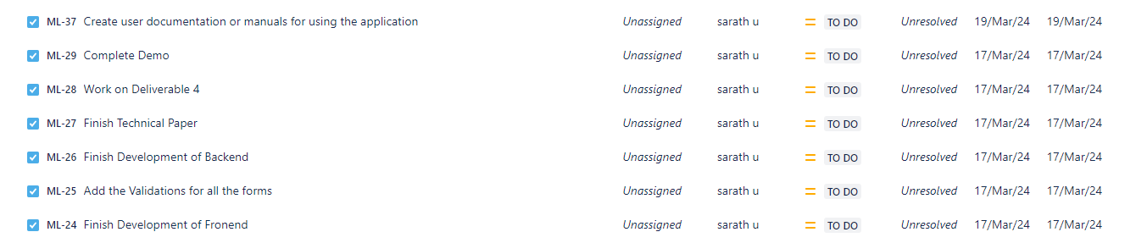
Product backlog

Slide 26
Stories and Acceptance criteria
User Stories And Acceptance Criteria
User Story ID | Summary
ML-10 | As a customer I want to able to create an account So that I can get access the Meal Mate Application
 | Scenario: Customer wants to use the application by registering “Given I’m in a role of customer When I open the registration page Then the system shows the registration form to create an account
ML-30 | As a customer I want to be able to login to the application So that I can see the Home Page
 | Scenario: Customer wants to login to the application “Given I’m in the role of customer When I open the login page Then the system shows me to enter username and password And the system shows Login button to sign-in to the application
ML-34 | As a signed-in customer I want to be able to Open the camera from the application So that I can take the picture of the vegetables
 | Scenario: Customer wants to take the picture of the vegetables to get the recipe suggestions “Given I’m in the role of signed-in customer When I open the camera module Then the system will open the camera to take the picture
ML-12 | As a signed-in customer I want to open the profile screen So that I can find all the details of the login customer and update the profile details
 | Scenario: Signed-in customer wants to see their profile details “Given I’m in the role of signed-in customer When I open the Profile module from the application Then the system shows the details of the signed-in customer.
ML-33 | As a signed-in customer I want to be able to open the History So that I can view my History
 | Scenario: Signed-in customer wants to see their suggested recipe history “Given I’m in the role of signed-in customer When I open the History module to view the history Then the system shows the whole history of my previous searches.

Slide 27

Sprint 3 Backlog

Slide 28
Test Cases
User Story ID | Unit to test | Assumptions | Test data | Steps to be executed | Expected Results
ML-53 | Forgot password | Should direct to the email to reset the password |  | Homepage-> Login -> Forgot Password | Password Reset and directed to login page again
ML-11 & ML-25 | Profile | Profile creation should be successful |  | Homepage-> Login-> Profile | Check all the details filled with valid zip codes and phone numbers.
ML-11 & ML-25 | Profile | Show an error with missing fields |  | Homepage-> Login-> Profile | Check to missing/mandatory fields*
ML-42 | Homepage | should display home page with camera icon |  | Homepage | Check if the categories are correct
ML-44 | Recipe Page | Recipe should display the list of suggested vegetables |  | Homepage ->Recipe | Check if the vegerables are displaying or not
ML-42 | Homepage | Customers should be able to access the homepage |  | Homepage | Once directed with url, you will be first redirected to homepage.
ML-44 | History | Customer should be able to search for images listed |  | Homepage-> History | History must provide the search box for user to search for desired services.
ML-44 | History | History displayed in search field should be relevant to logged in user only |  | Homepage-> History | Search box on History must display relevant information previously searched by the user.

Slide 29
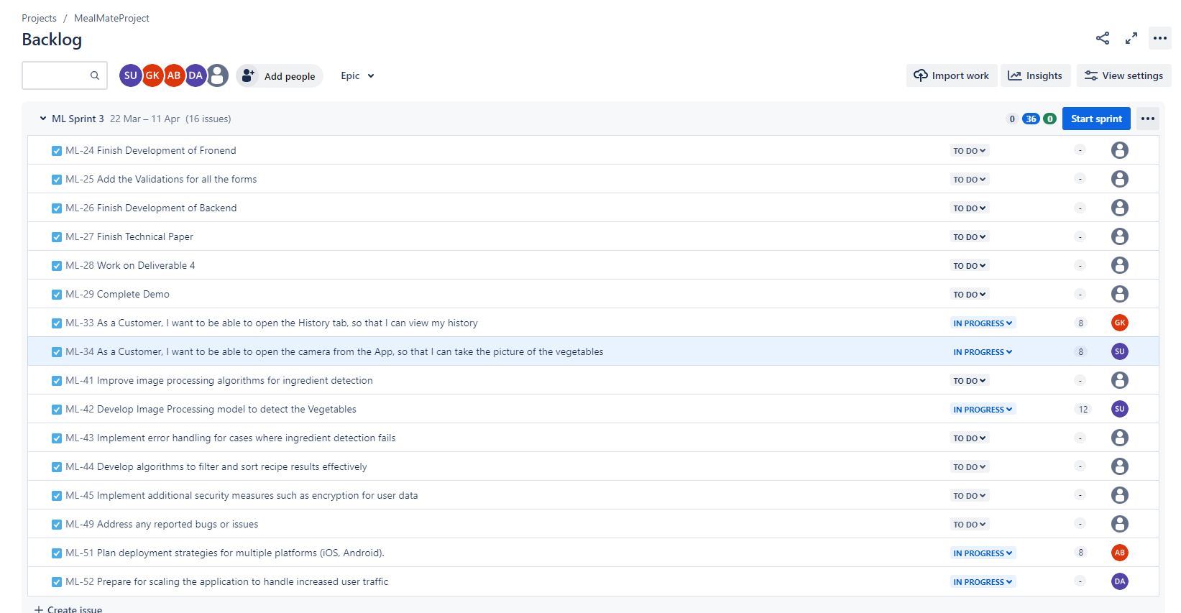
Sprint 3 Backlogs

Slide 30

Metrics

Slide 31
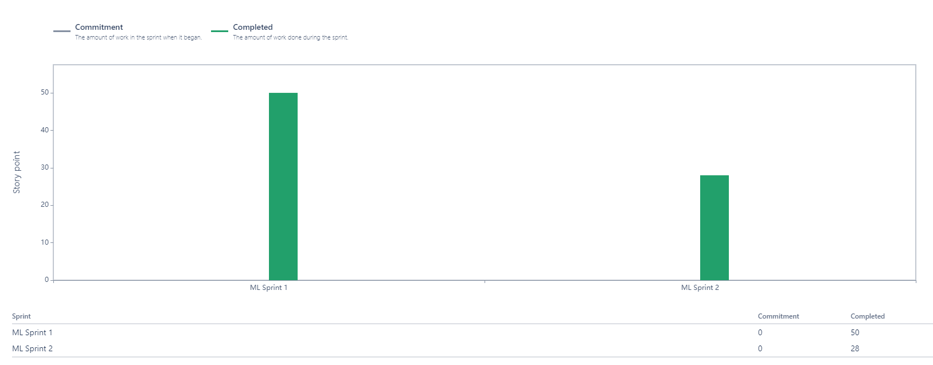
Team Velocity

Slide 32
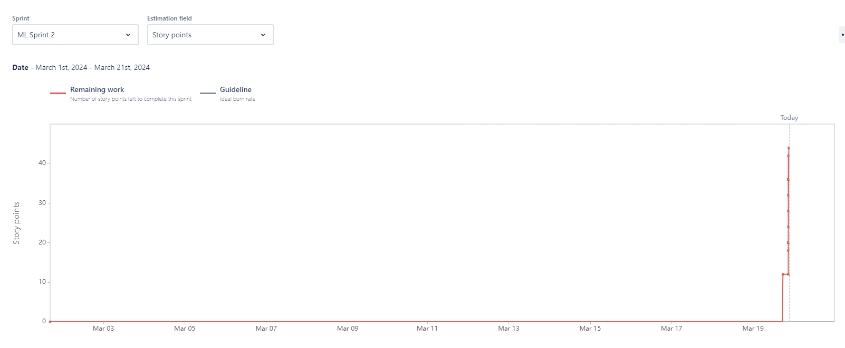
Burndown Chart

Slide 33
Completed/Committed Ratio

Slide 34

Retrospective

Slide 35

What Went Well
Because of Slack, we are able to communicate well be connected
Teamwork helped in requirement gathering.
We have listed down the technologies which will be used. Although we still need to learn the concepts in depth to be able to make a good product.
Using JIRA has helped us to track the status

Slide 36
What need improvements
Meeting schedules have to be planned carefully.
Team participation requires a slight improvement.
Regular updating of JIRA tasks should be done by the team

Slide 37
Next Steps
Proper availability of time needs to be discussed.
Get a clear idea of deadlines to finish the tasks as per schedule.
Start working on the activities assigned.

Slide 38
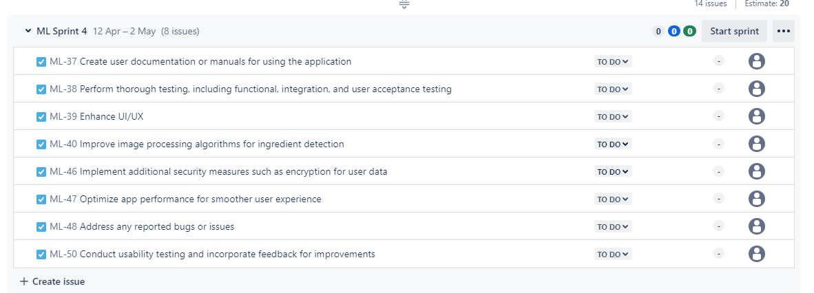
Sprint 4 tasks

Slide 39

Project Demo Sprint 2

Slide 40
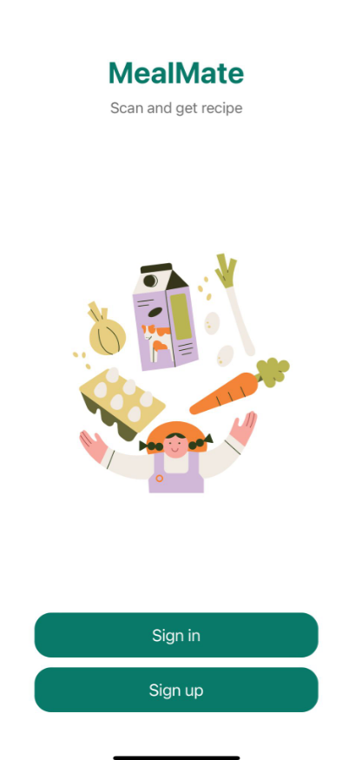
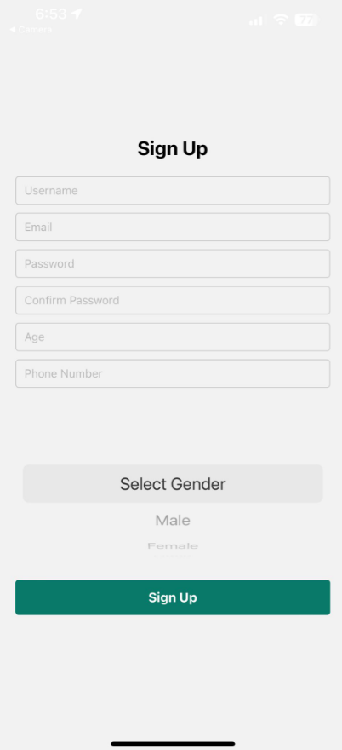

Slide 41
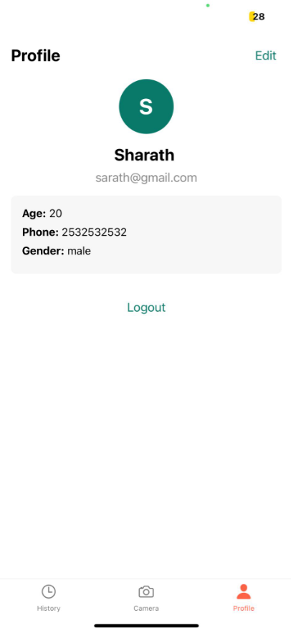
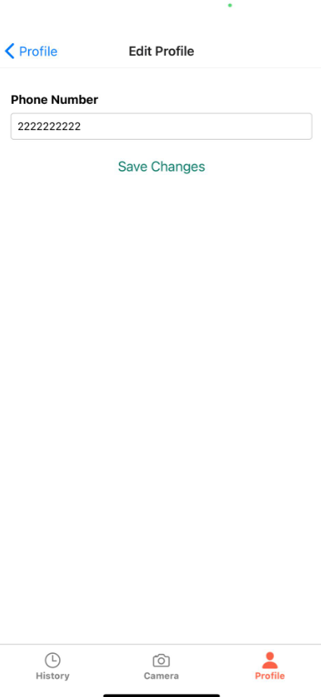
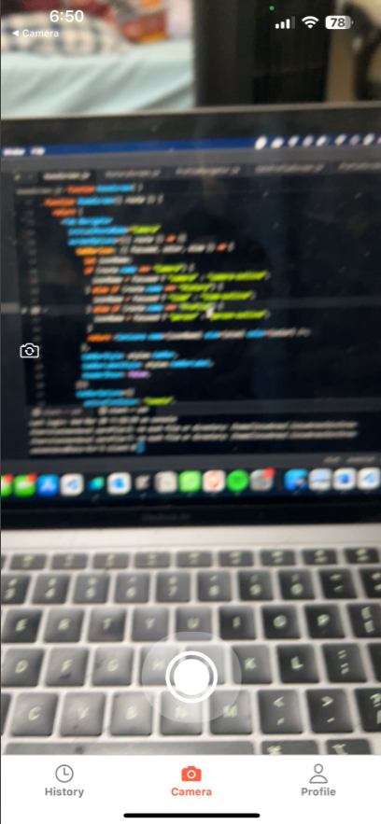

Slide 42
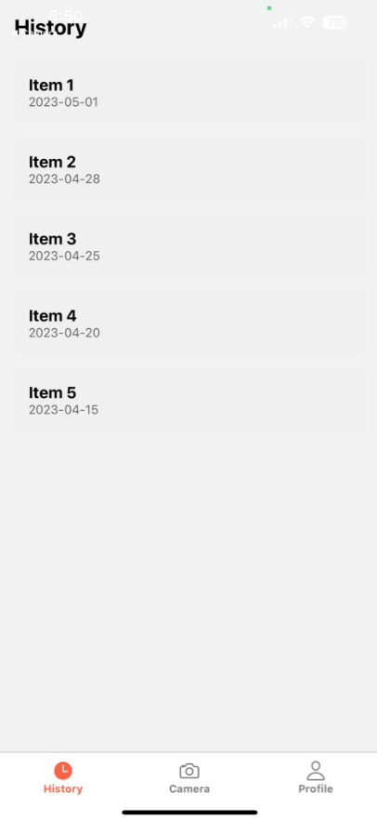

Slide 43
Wiki page Link
https://github.com/upadristasarath/CS691_CapstoneProject_MealMate/wiki

Slide 44

Thank you

